Slide 1


ML project on Mail Classifier
Sunnapuralla Bhargavi

Slide 2

About Me: I am pursuing 3rd year B.Tech in branch of Artificial Intelligence and Data Science in Aditya college of Engineering ,Madanapalli. I’m working as a Data science intern at Internx
Experience: I am currently doing my internship on Data Analysis and Machine learning , gaining valuable hands-on experience and insights into real-world applications of these technologies.
Linkedin and github:
http://www.linkedin.com/in/bhargavi-s-20120b2a1
https://github.com/SunnapurallaBhargavi

Slide 3
Agenda
Objective
Data Description
Data Analysis
Data Cleaning
Splitting the data
Building model and performance of model
conclusion

Slide 4
Objective
To identify and filter out spam or phishing emails, enhancing security and reducing clutter in the user's inbox.
To automatically sort incoming emails into relevant folder to save time and effort for the user.
To improve the overall email management experience for users by reducing manual sorting and filtering tasks.
To analyze the content of emails for specific topics, sentiments, or actions required, enabling better organization and response management.

Slide 5
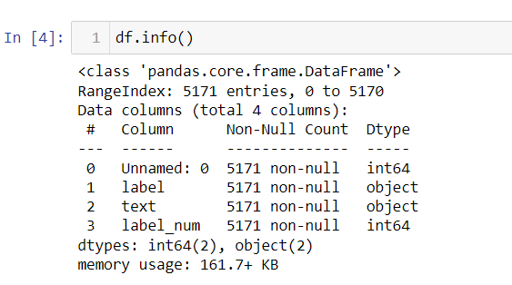
Data Description
Data Frame consists of 5171 rows and 4 columns
text – contains text regarding spam and ham mails.
label –indicates spam or ham
label_num – spam=1,ham=0

Slide 6
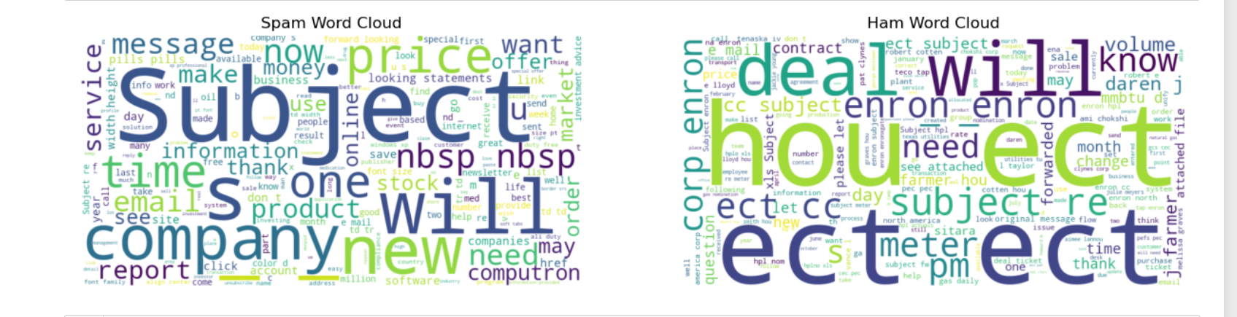
Word cloud of text column

Slide 7
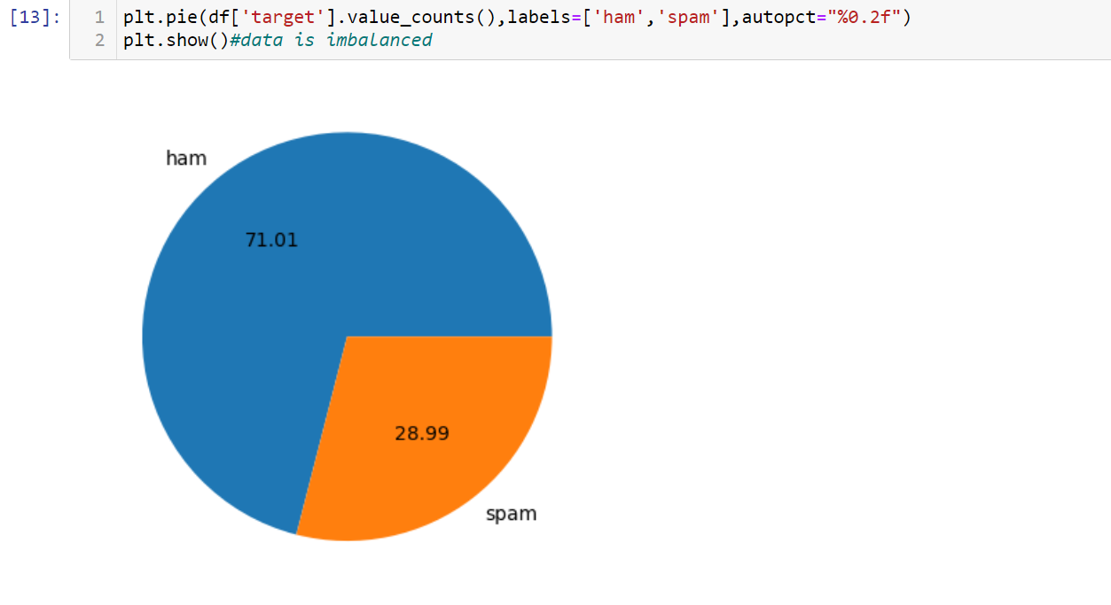
Data Analysis
We can see 71% of mails are ham and rest of 28% are spam.

Slide 8
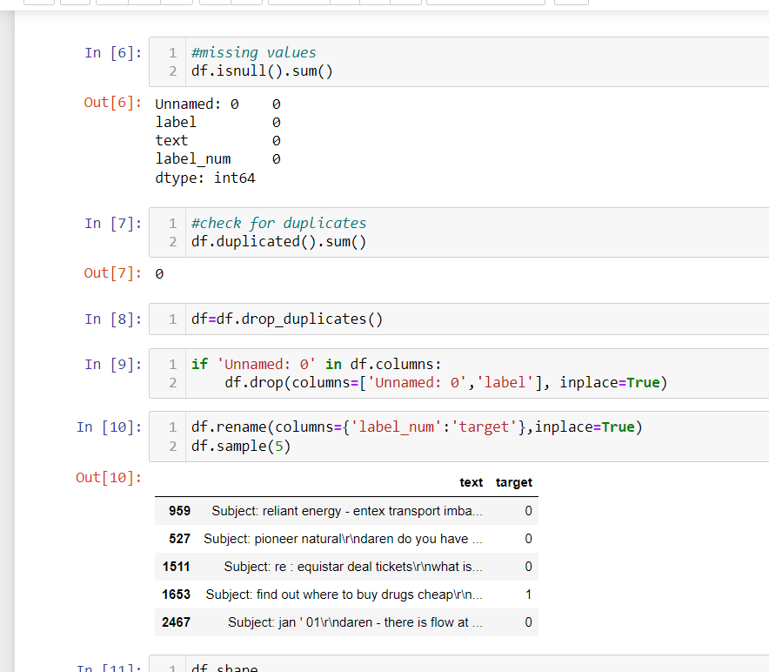
Data cleaning
The data has no missing values and duplicates.
From 4 columns I have taken ,text and target features to implement model.

Slide 9
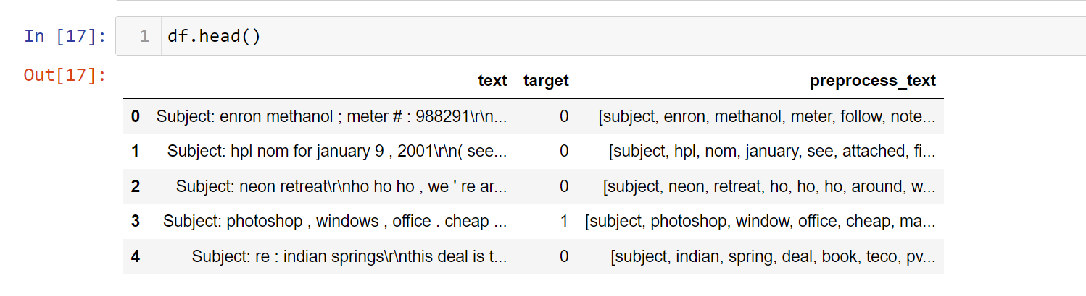
Data cleaning
Basic preprocessing like removal of punctuations ,digits,special characters ,stopwords,tokenaization and Lemmatization is

Slide 10
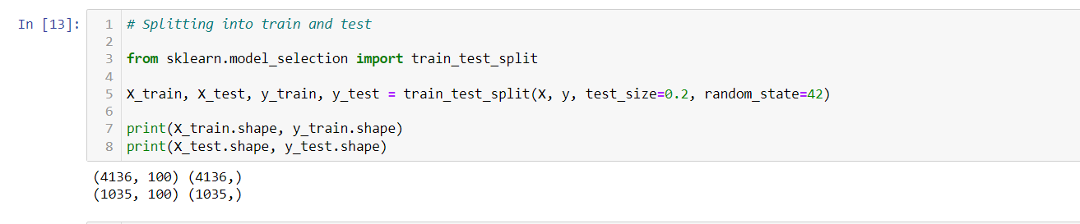
Splitting the data
After vectorization of preprocessed_text using word2vec method, split the data.

Slide 11
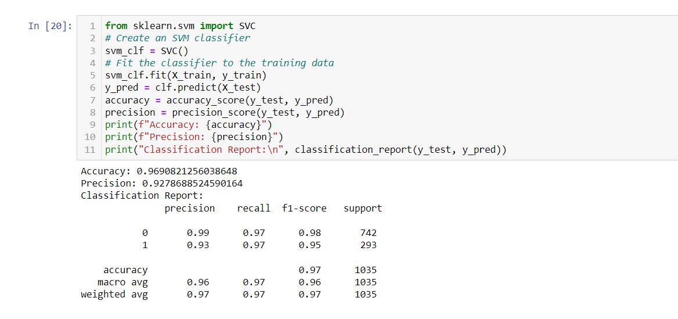
Model performance using svm

Slide 12
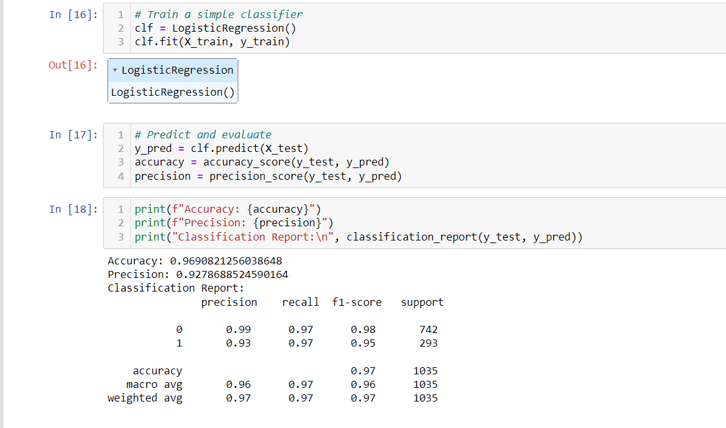
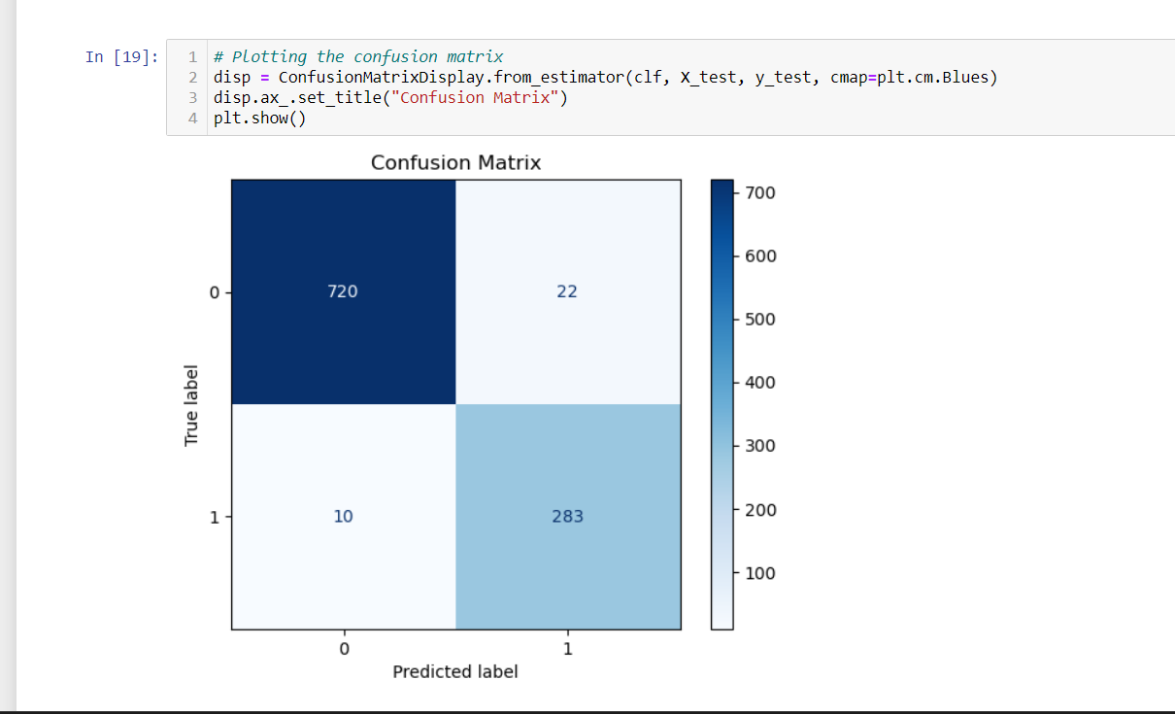
Model performance using Logistic Regression

Slide 13
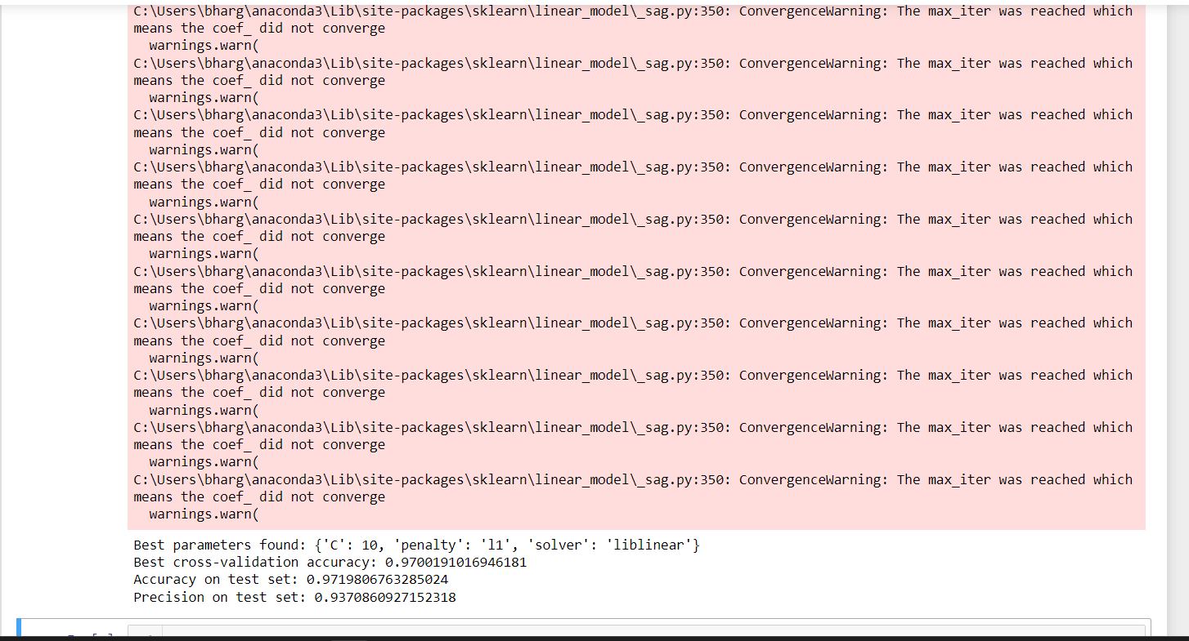
Hyper parameter Tuning

Slide 14
Conclusion:
Data consists of more ham mails compared to spam.
Data is imbalanced.
From word cloud we can conclude spam have words like hou,ect,contract,need to attract the people.
For the Mail classification, Logistic regression model has high accuracy of 96%.
From confusion matrix of Logistic regression :
True positives are 720 and True Negatives are 283(model correctly classified).
False positives are 22 and False Negatives are 10( Type I & Type II errors).

Slide 15

Thank you

